Slide 1

Capstone Project – I: Review – 2 on
Energy Efficiency Optimization using IoT-Driven Power Consumption Analytics
Presented by the Batch No. : XXX
S.Sai Varma (VU22CSEN0102367)
S. Manjith (VU22CSEN0101270)
Himanshu Singh (VU22CSEN0101246)
P.Lokesh (VU22CSEN0101012)
Under the Guidance of
M N Vamsi Thalatam
Associate Professor
Department of Computer Science and Engineering
GITAM School of CSE, GITAM (Deemed to be University),
Visakhapatnam.

Slide 2
CONTENTS
Recap of Capstone Project Introduction Review-1
Problem Statement
Objectives
Feedback from Guide/Reviewers and actions taken after Review–1
Requirement Analysis
Identification of tools/technology/algorithms
Design Strategy (project workflow/ system design/ DFD/UML design)
Conclusion
References

Slide 3
Recap from review-1
• Presented the problem of inefficient energy consumption in households/industries.
• Showed literature survey on IoT + ML-based energy optimization.
• Demonstrated initial understanding of clustering & forecasting concepts.
• Received feedback to refine research gaps and provide a clearer execution roadmap.
1

Slide 4
Problem Statement
Traditional energy systems lack real-time monitoring, behaviour analysis, and consumption forecasting.
This makes it difficult to:
Identify inefficient energy usage behaviour
Predict future power demand
Optimize appliance schedules
Reduce electricity cost and wastage
Need: A unified IoT + ML system for real-time monitoring and predictive analytics.
1

Slide 5
Objectives
Phase 1 – Machine Learning Model Development
Build ML models to analyze historical consumption patterns (Clustering).
Develop an LSTM-based forecasting model for next-hour energy prediction.
Phase 2 – IoT System Integration
Integrate ESP32 + PZEM-004T sensors for real-time data acquisition.
Connect ML models to IoT pipeline for live predictions & recommendations.
1

Slide 6
Feedback from Guide/Reviewers and actions taken after Review–1
Feedback
Research gaps not clearly identified
No clear execution roadmap shown
Need clarity on ML techniques & architecture
Actions Taken
Research gaps refined (dataset limitations, lack of real-time systems, missing multivariate forecasting).
Detailed project workflow prepared (from dataset → ML → IoT → dashboard).
Implemented clustering model + started LSTM model for forecasting.
1

Slide 7
Requirement Analysis
Hardware Requirements
ESP32 microcontroller
PZEM-004T energy sensor
CT coil / voltage sensor module
Wi-Fi router
Laptop/PC for ML model deployment
Software Requirements
Python (Pandas, NumPy, Scikit-Learn, TensorFlow/Keras)
MQTT or REST API
Google Colab
Database: Firebase
Dashboard: Streamlit / React
2

Slide 8
Identification of tools/technology/algorithms
Tools
Python, Jupyter Notebook
Google Colab
VS Code
ESP32 Arduino IDE
3

Slide 9
Identification of tools/technology/algorithms
Technologies
IoT Sensor Integration (ESP32 + PZEM-004T)
MQTT / HTTP communication
Machine Learning (Clustering, LSTM)
3

Slide 10
Identification of tools/technology/algorithms
Algorithms
K-Means Clustering – detect behaviour patterns
LSTM Deep Learning Model – demand forecasting
3

Slide 11
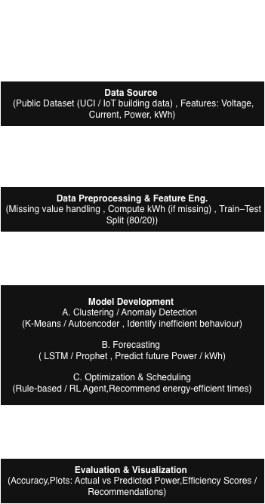
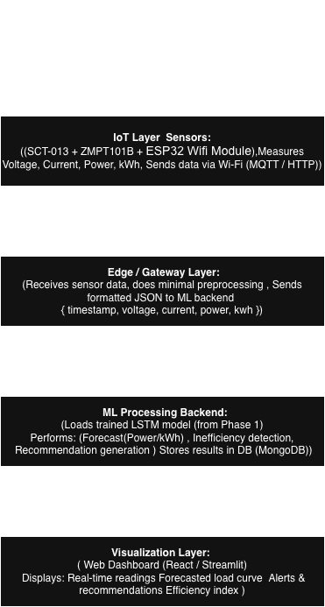
Design Strategy
Project Workflow
Phase 1 : Model Building
Phase 2 : Extedning to IOT
4

Slide 12
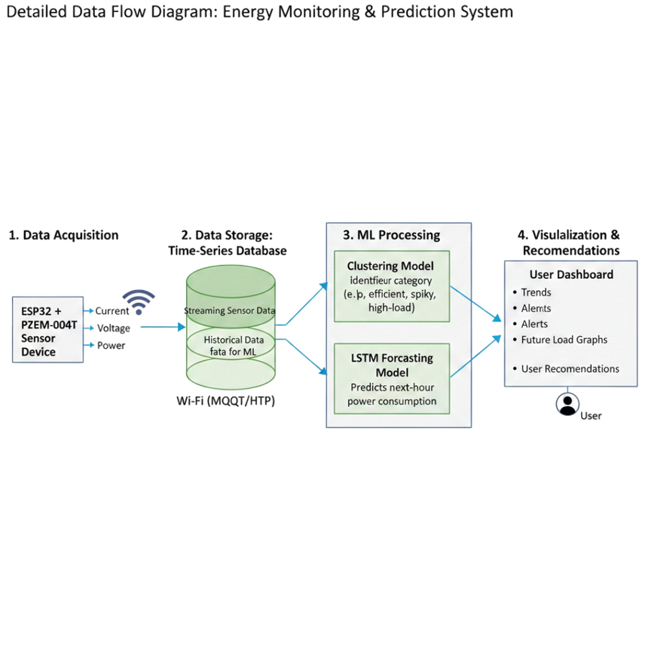
Design Strategy
System Design
Components:
IoT Layer: ESP32, PZEM sensor
Data Layer: local storage / Firebase
ML Layer:
Clustering model for behaviour segmentation
LSTM model for forecasting
Application Layer: Web/Mobile dashboard
Recommendation Engine: Suggests optimal usage times
4

Slide 13
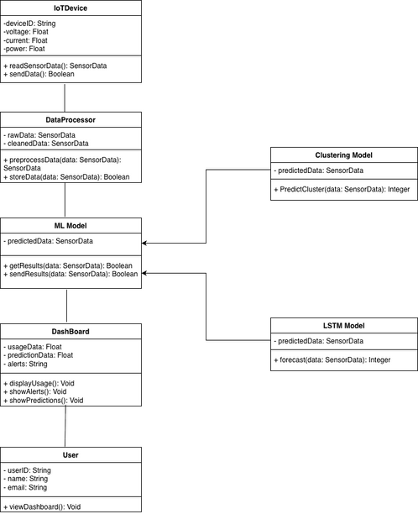
Design Strategy
Class Diagram
4

Slide 14
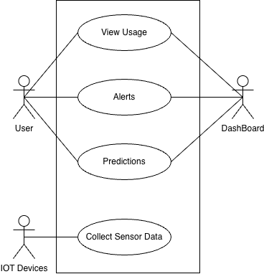
Design Strategy
UseCase Diagram
4

Slide 15
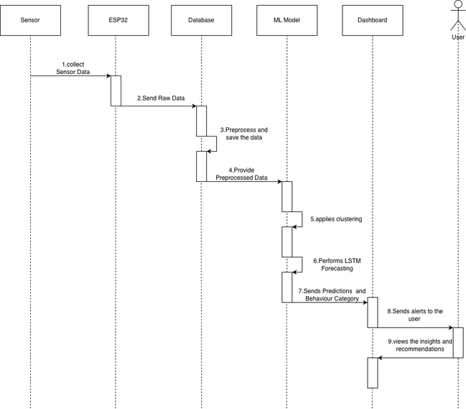
Design Strategy
Sequence Diagram
4

Slide 16
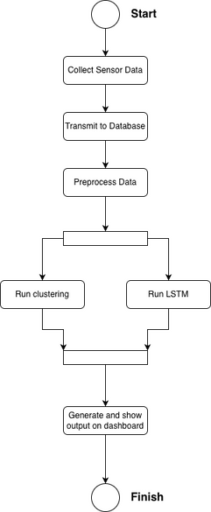
Design Strategy
Activity Diagram
4

Slide 17
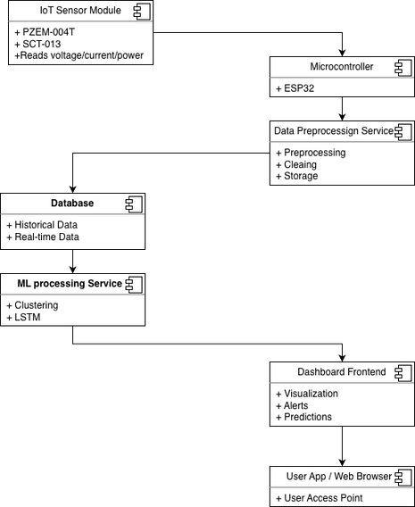
Design Strategy
Component Diagram
4

Slide 18
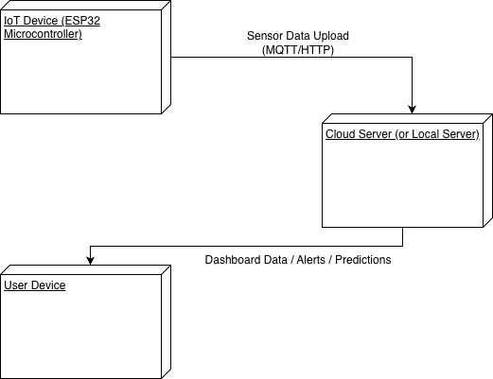
Design Strategy
Deployment Diagram
4

Slide 19
Conclusion
Completed literature survey & identified strong research gaps
Clustering model implemented successfully
LSTM future consumption model partially completed
Clear plan for IoT integration and dashboard development
5

Slide 20
References
[1]Hebrail, G. & Berard, A. (2006). Individual Household Electric Power Consumption [Dataset]. UCI Machine Learning Repository. (https://doi.org/10.24432/C58K54).
[2] Time-Series Forecasting Models for Smart Meters Data: An Empirical Comparison and Analysis (https://iieta.org/journals/jesa/paper/10.18280/jesa.570517)
[3] PZEM-004T & SCT-013 Sensor Datasheets.
[4] Energy Optimization Research Papers (IoT, ML, Smart Grids)
[5] TensorFlow and Scikit-Learn Documentation
[6] Clustering Model Colab Link(https://colab.research.google.com/drive/1-U-GMgeKRNzcrYV4kobnuwHlzqKPd7IP)
[6] LSTM Model Colab Link(https://colab.research.google.com/drive/1-U-GMgeKRNzcrYV4kobnuwHlzqKPd7IP)
6

